Slide 1
Computing the Start of Reionization
Calculate parameters necessary
  Clumping factor
  Luminosity Density
  SFR Density
Ensuring SFR Density is realistic
  Jean's Mass
Equate Critical SFR density and SFR Density

Slide 2
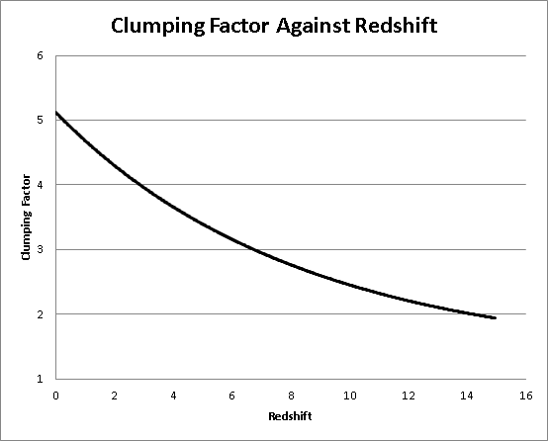

Slide 3
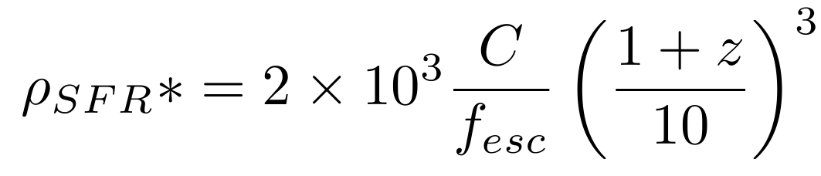
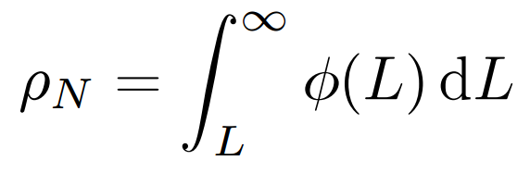
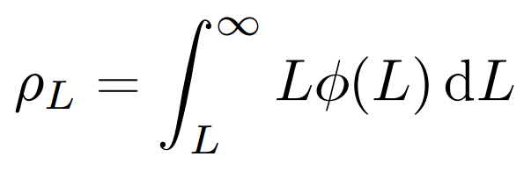

Slide 4
Computing the Timescale of Reionization & Its End
Calculation of rate of ionizing photons
Equating to number of hydrogen particles
Estimate reionization timescale
Convert time in seconds to redshift.

